Slide 1
Day 2
AI Based Computer Vision Accident Detection
Reuben George Mathew
Jeffrey Aaron Paul
Rohan Jamadagni
Sandeep S Budhya
RG Shruthii
Jennifer Jeeyar
Runtime Terror
DSCE, Bangalore
PS Number: IC463
Category: Smart Cities (AICTE)

Slide 2
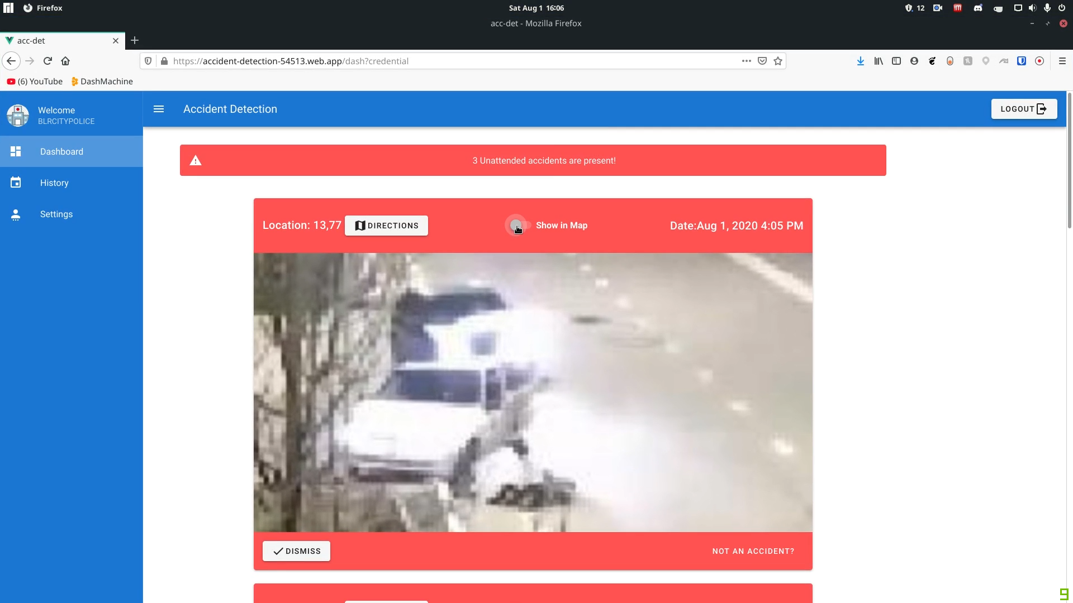
Completed
AI Model to classify accidents.
Algorithm to detect collisions.
Optimization of proximity algorithm.
Web-App.
Hosting of Web Application.
Use of IP Camera to simulate a CCTV.

Slide 3
Web App
Introduce Multiple Users and the ability of those users to receive the notifications simultaneously.
Sign Up Page along with coordinates selection.
Improve Web App UI and Landing Page.

Slide 4

LEND A HELPING HAND TO VICTIMS OF ROAD ACCIDENTS!
SIGN UP TODAY!
Community Outreach

Slide 5

Community Outreach Program
Create a community of like-minded volunteers to help out with first aid before the ambulance might arrive.
Volunteers after background checks can be added into the program.
A notification of the accident along with it’s details can be uploaded through WhatsApp/SMS and interested parties can respond with basic medical care.
Target Individuals from Medical Backgrounds
Would reduce the Time of Response even further, thus improving survival rates.

